Slide 1
Organizational remarks
Introducing Emil
Room for lectures is J243 from now on
Choosing agile practices in the group
Suggestion 1: Start with Scrum, add a bit more
Suggestion 2: As an individual, select 2-3 practice, make them work in your team, focus on this in your report
E.g. define a fixed time per week for pair programming
One of your group: Prepare to present your group’s selection of practices on Apr-4 (<5min, no slides)
Please look into the Kanban video before Apr-4

Slide 2
Task description
Agile Development Processes 2014
Eric Knauss

Slide 3
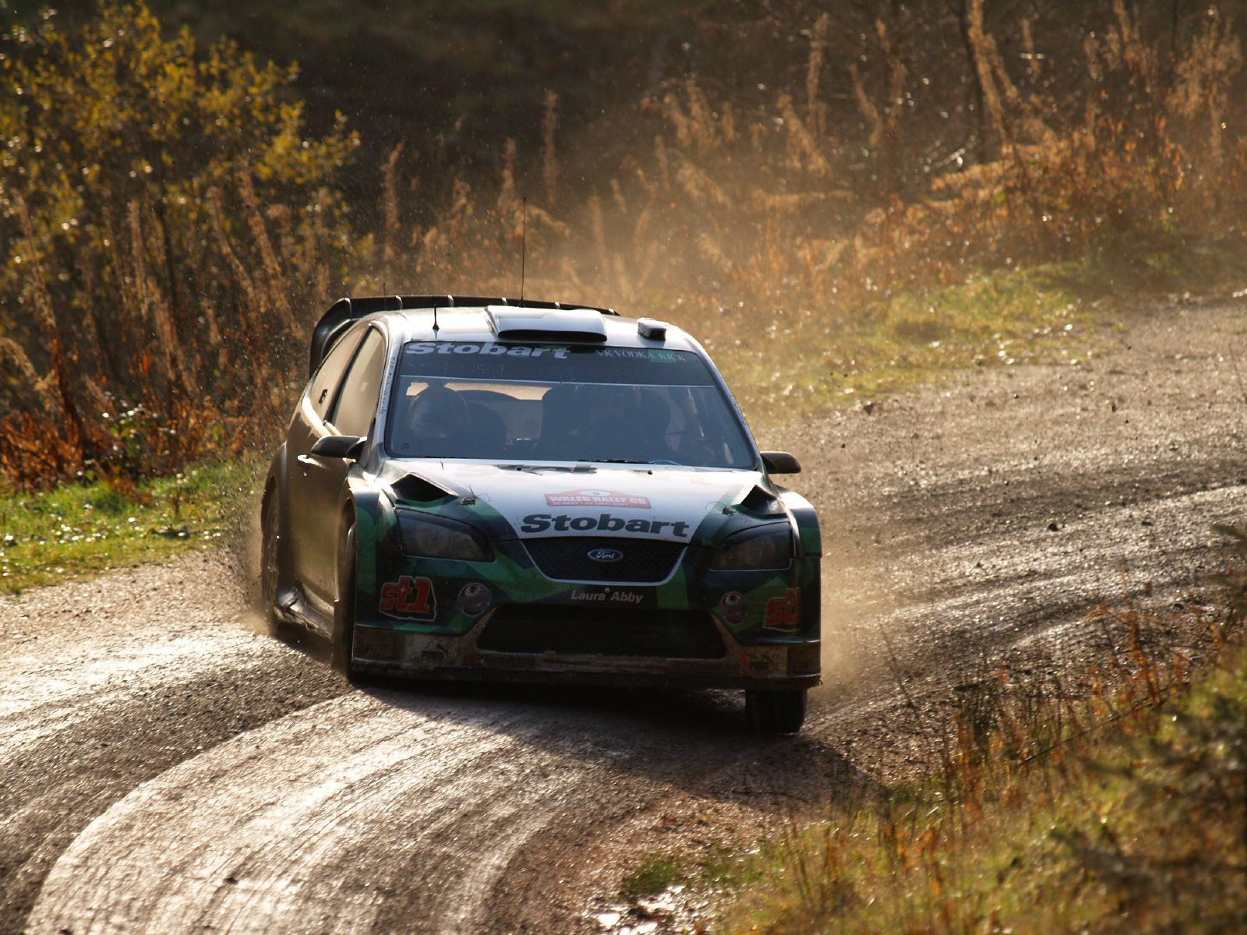
Pair programming
Navigator
Driver
Task
http://upload.wikimedia.org/wikipedia/commons/b/bd/Jari-Matti_Latvala-2007_Wales_Rally_GB_001.jpg

Slide 4

We know the tools of the driver…
https://flic.kr/p/77rfcL

Slide 5
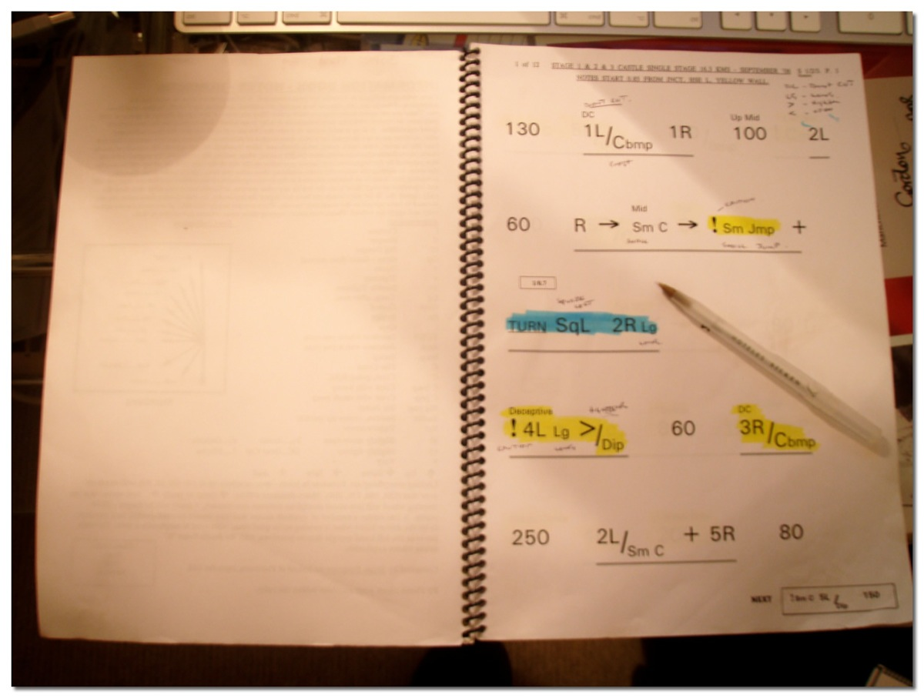
It is time to take care of the navigator…
http://en.wikipedia.org/wiki/File:Pacenotes.jpg

Slide 6


Task: Pair Programming Pacenotes
Rally
Pair Programming
http://civic.mit.edu/blog/natematias/pair-research-low-fi-tools-for-collaboration-in-teams
http://en.wikipedia.org/wiki/File:Peugeot_206_WRC.jpg
Primary
Know state of master branch
Know position of other team-members
Primary
Know road conditions
Know position of other teams
Secondary
Prepare for track
Measure/analyze performance
Secondary
Support planning game
Measure/analyze velocity

